Slide 1
Generics and more
Java Advanced
Spring 2016

Slide 2
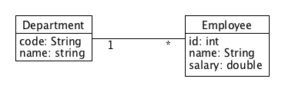
Generics – the problem

Slide 3
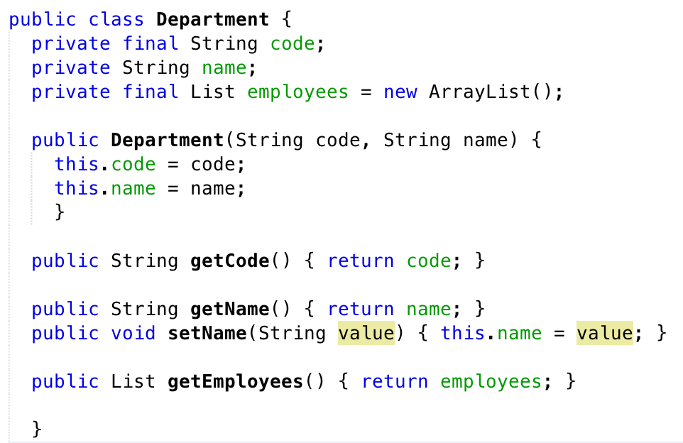
The Department

Slide 4
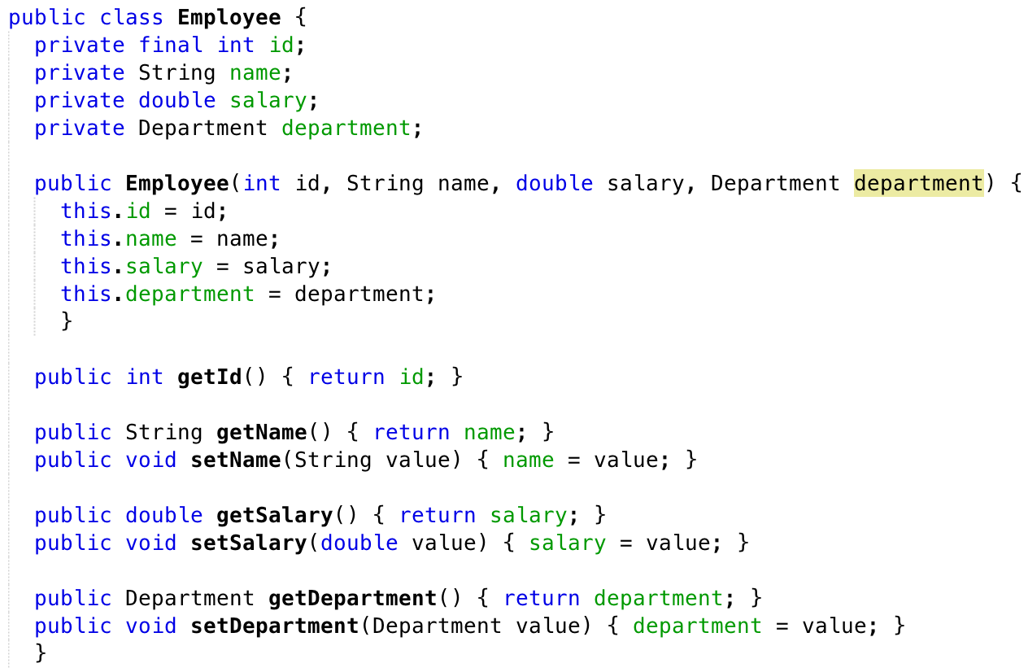
The Employee

